Slide 1
How to use this file
This file serves three purposes:
Act as a branding guideline and resource for Dapr
Provide a core set of slides to use when presenting Dapr
Provide additional slides for deep-dive presentations.
NOTE: You should customize this deck to your needs depending on the audience. The Slide Assets section at the end of this deck contains many assets that you can use to create more diagrams.
How to request updates this file:
Create an issue in https://github.com/dapr/community with details on what you’d like to add/update

Slide 2




Guidelines for building diagrams
App label
Apps are represented by a hexagon.
App labels use the Space Grotesk font.
When using only one App, use the green hexagon.
When more than one application is present in a diagram, use alternate hexagon colors, with light blue, yellow and teal.
The Dapr sidecar is represented by a white hexagon with a light blue border containing the Dapr logo.
The sidecar icon can be in any corner if needed, although the bottom right is preferred.
App label
App label
App label

Slide 3


Guidelines for building diagrams
A key/value store is represented by a yellow vertical wide pipe.
A message broker is represented by a green horizontal narrow pipe.
Labels are in Space Grotesk font.
Use 2pt size black arrows for connecting elements.
Database
Message broker

Slide 4


Dapr
APIs for building secure and reliable microservices
[Speaker]

Slide 5




Distributed applications
Front-end
Gateway
Shopping cart
Inventory
Storage
Notifications
Checkout
Message broker
Shipping
Shipping
Payment
Storage
Storage

Slide 6
Developer challenges – Service orchestration
Front-end
Gateway
Shopping cart
Inventory
Storage
Notifications
Checkout
Message broker
Shipping
Shipping
How do I orchestrate business logic across services?
Payment
Storage
Storage

Slide 7
Developer challenges – Distributed tracing
Front-end
Gateway
Shopping cart
Inventory
Storage
Notifications
Checkout
Message broker
Shipping
Shipping
How can I trace requests across services and message brokers?
Payment
Storage
Storage

Slide 8
Developer challenges – Access control
Front-end
Gateway
Shopping cart
Inventory
Storage
Notifications
Checkout
Message broker
Shipping
Shipping
How can I configure access to services and other resources?
Payment
Storage
Storage

Slide 9
Developer challenges – Resiliency
Front-end
Gateway
Shopping cart
Inventory
Storage
Notifications
Checkout
Message broker
Shipping
Shipping
How do I handle failed calls and perform retries?
Payment
Storage
Storage

Slide 10
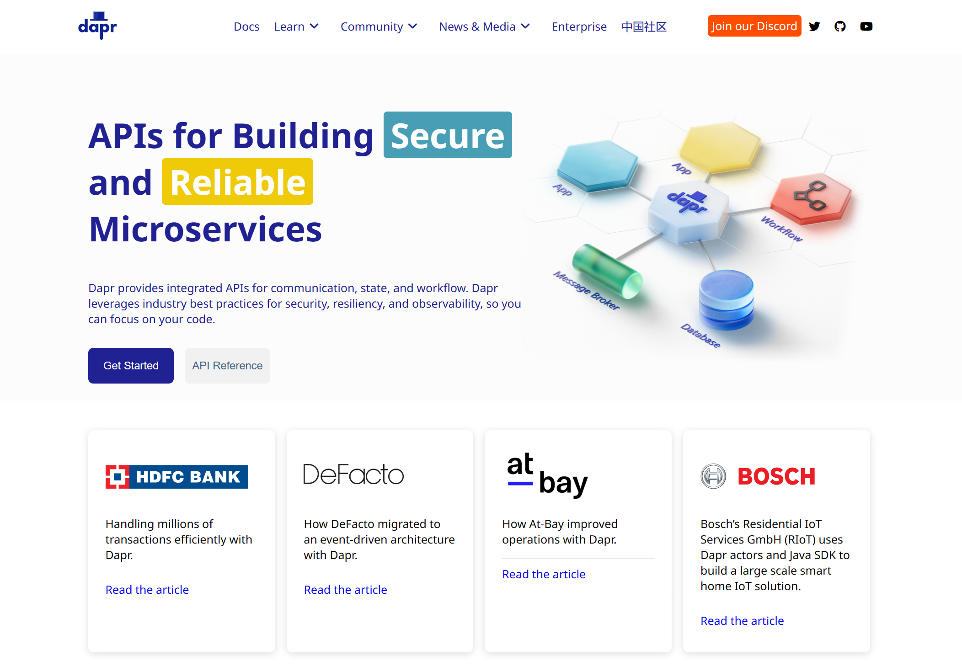

Distributed Application Runtime
dapr.io

Slide 11
Dapr uses a sidecar pattern
Front-end
Gateway
Shopping cart
Inventory
Storage
Notifications
Checkout
Message broker
Shipping
Shipping
Payment
Storage
Storage

Slide 12
The Dapr sidecar provides built-in security, resiliency and observability capabilities.

Slide 13
Speeds up application development by providing an integrated set of APIs for communication, state, and workflow.

Slide 14




State of enterprise developers
Must develop resilient, scalable, distributed apps that interact with services.
Want to focus on writing code, not learning infrastructure.
Trending toward serverless platforms with simple code to cloud pipelines.
Use multiple languages and frameworks during development.

Slide 15



What is holding back distributed app development?
Limited tools and runtimes to build distributed applications.
Runtimes have limited language support and tightly controlled feature sets.
Runtimes only target specific infrastructure platforms with limited portability.

Slide 16




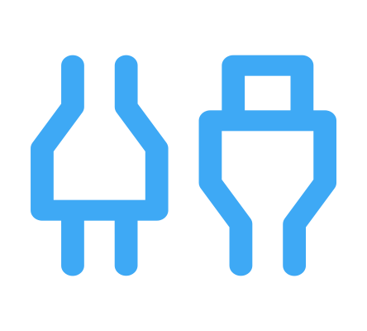

Dapr Goals
Provide an integrated set of APIs
Any language or framework
Includes best practices & standards
Platform agnostic
Extensible and pluggable
Community driven, vendor neutral

Slide 17

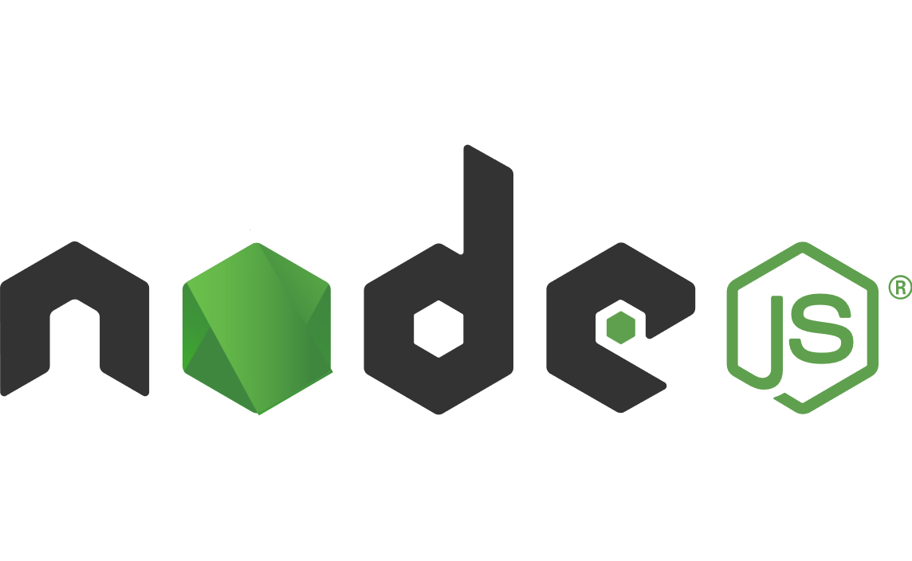


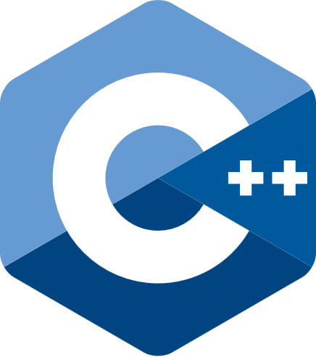




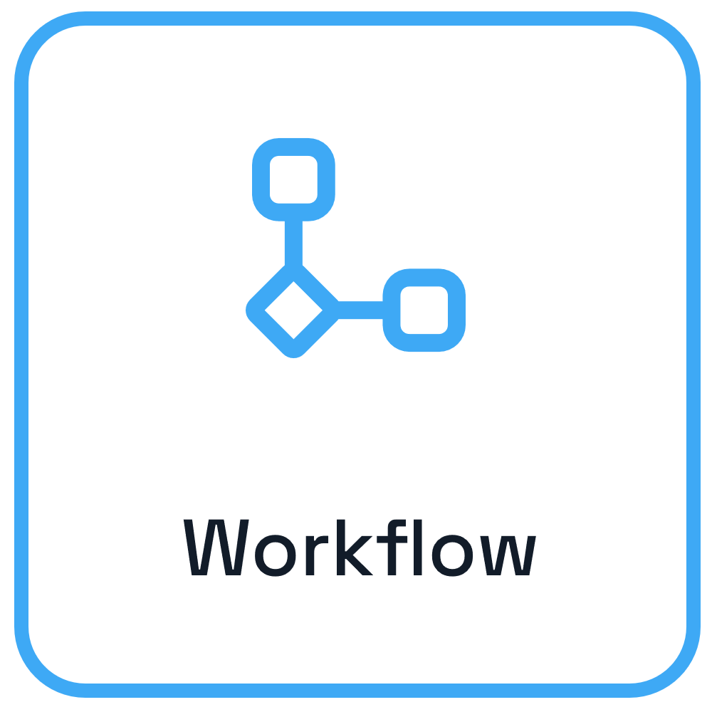

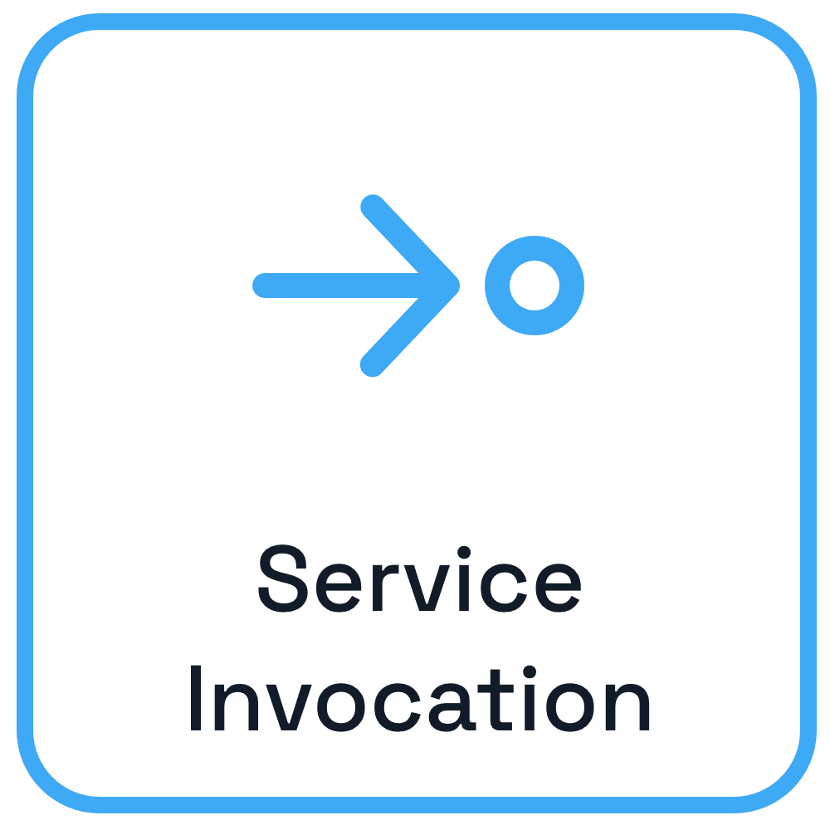
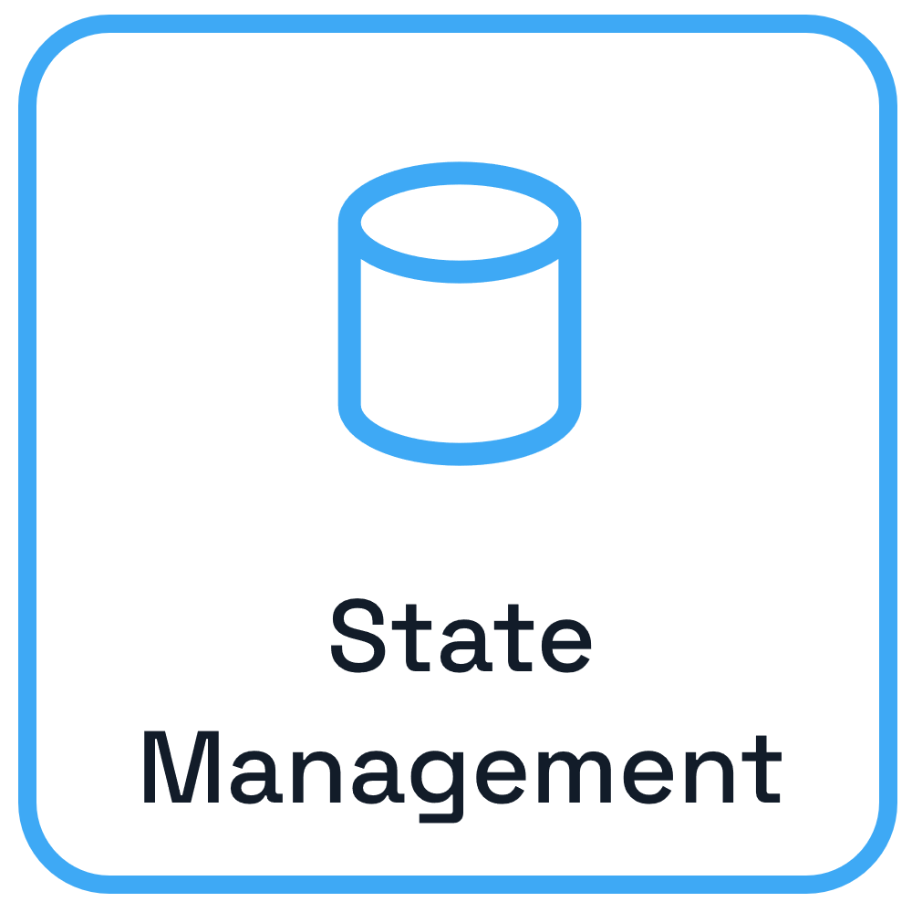
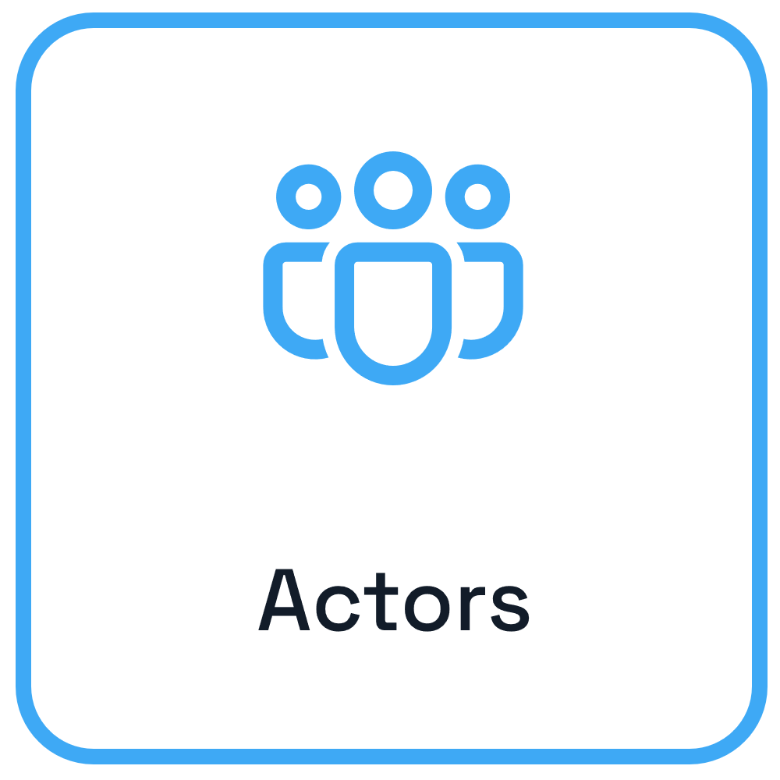
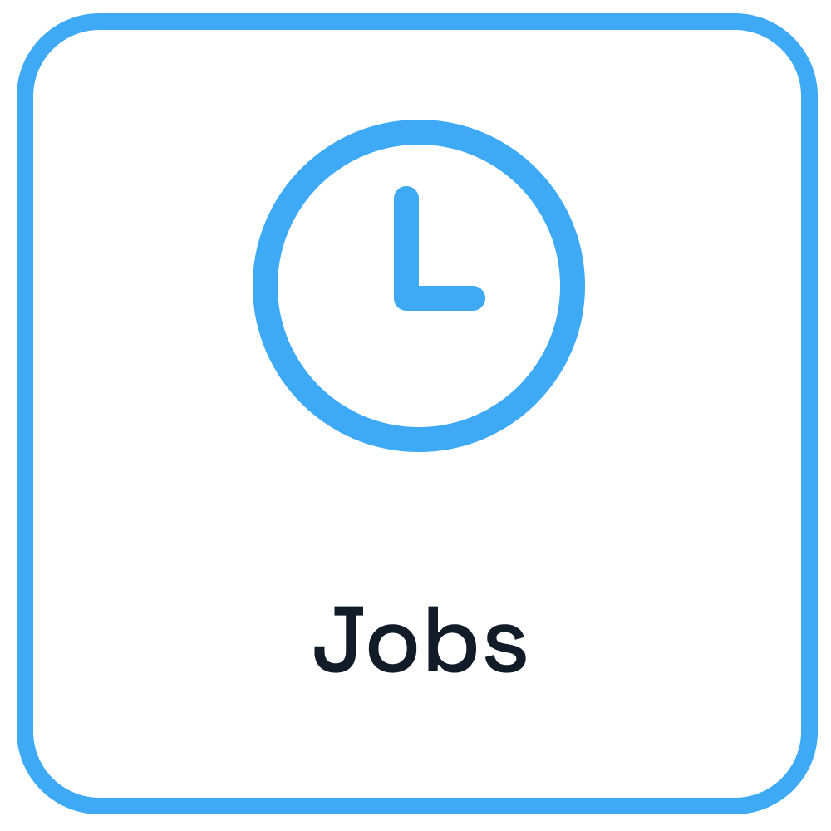


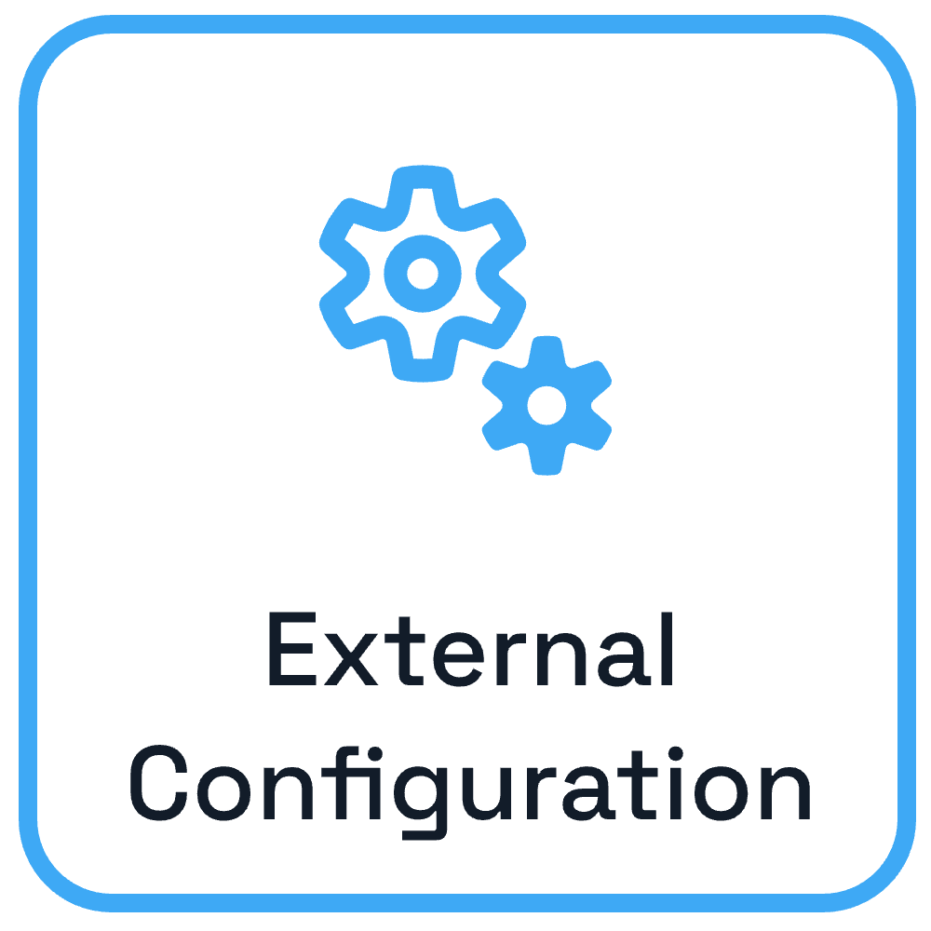

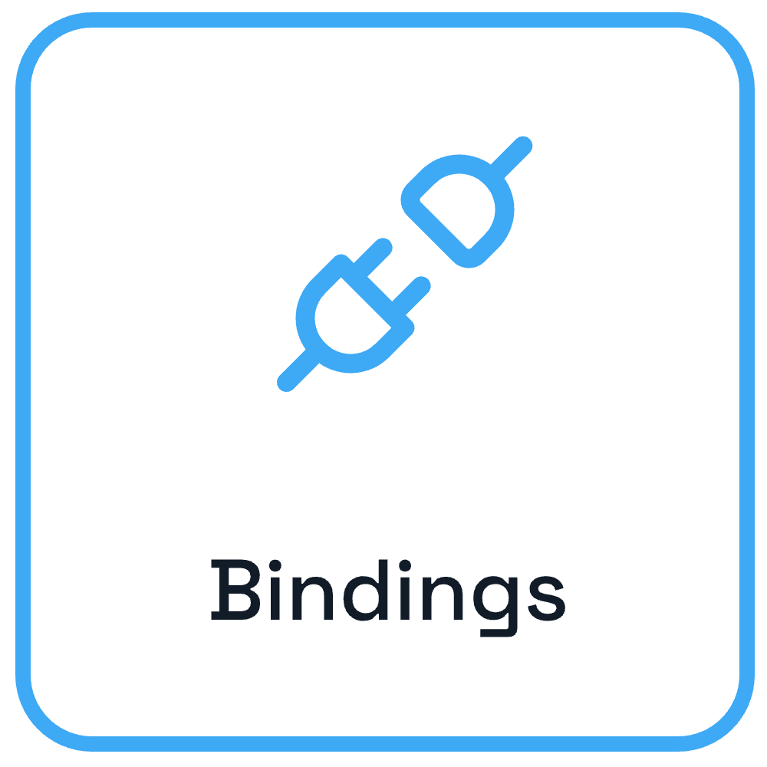
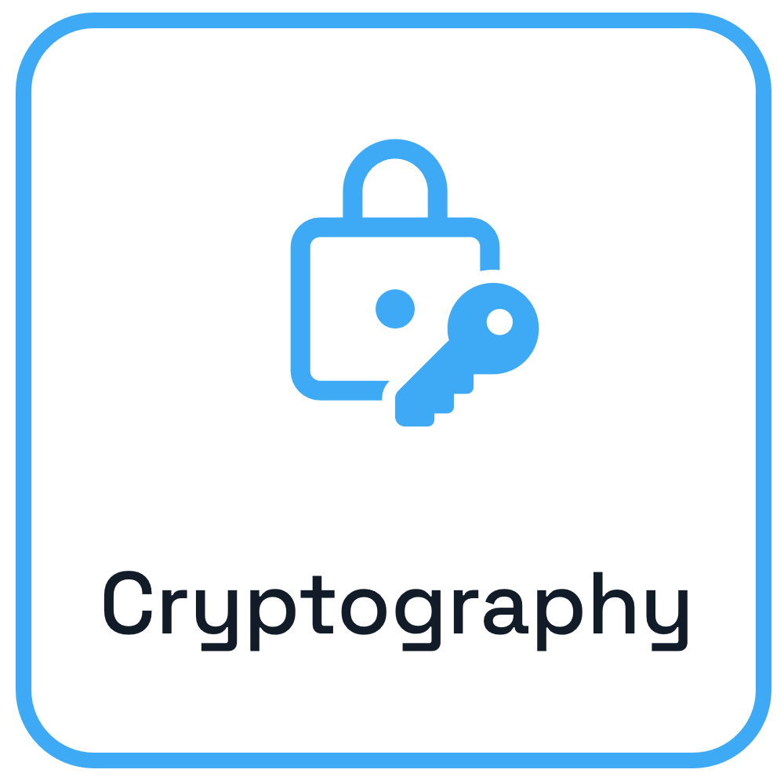
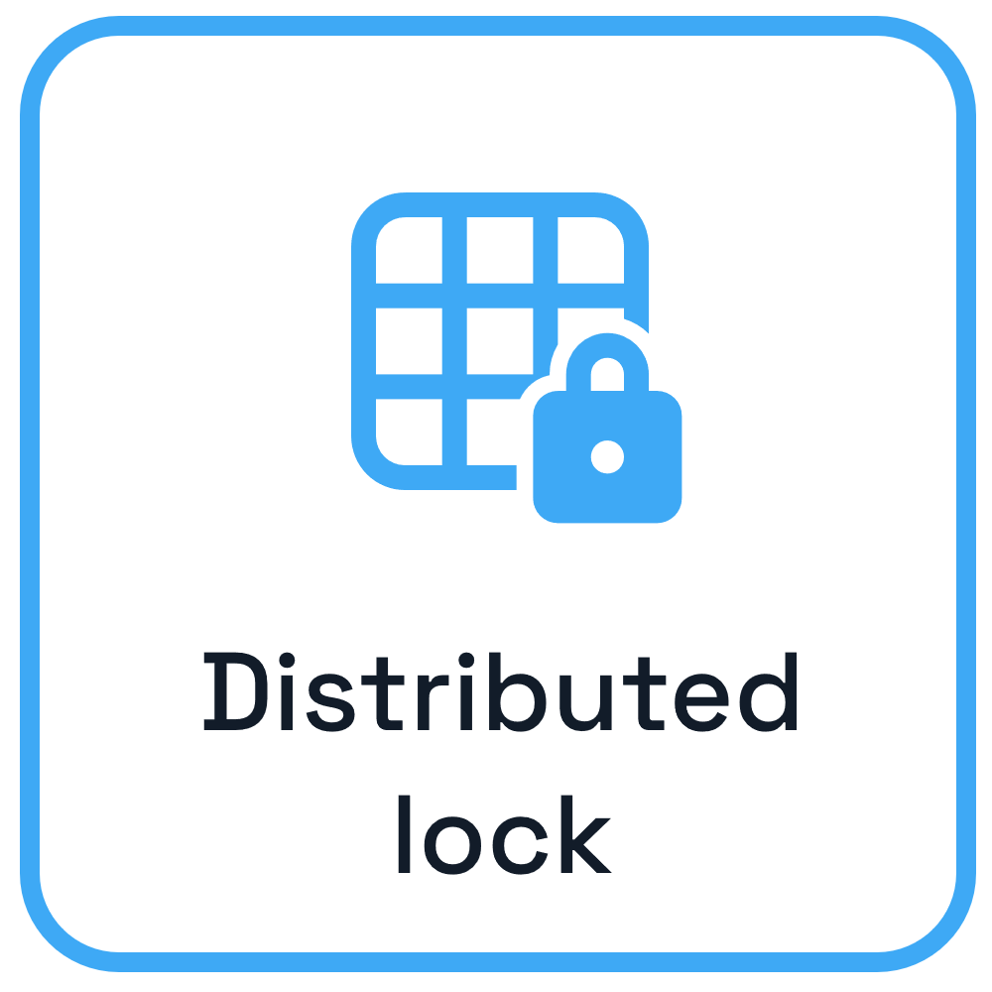
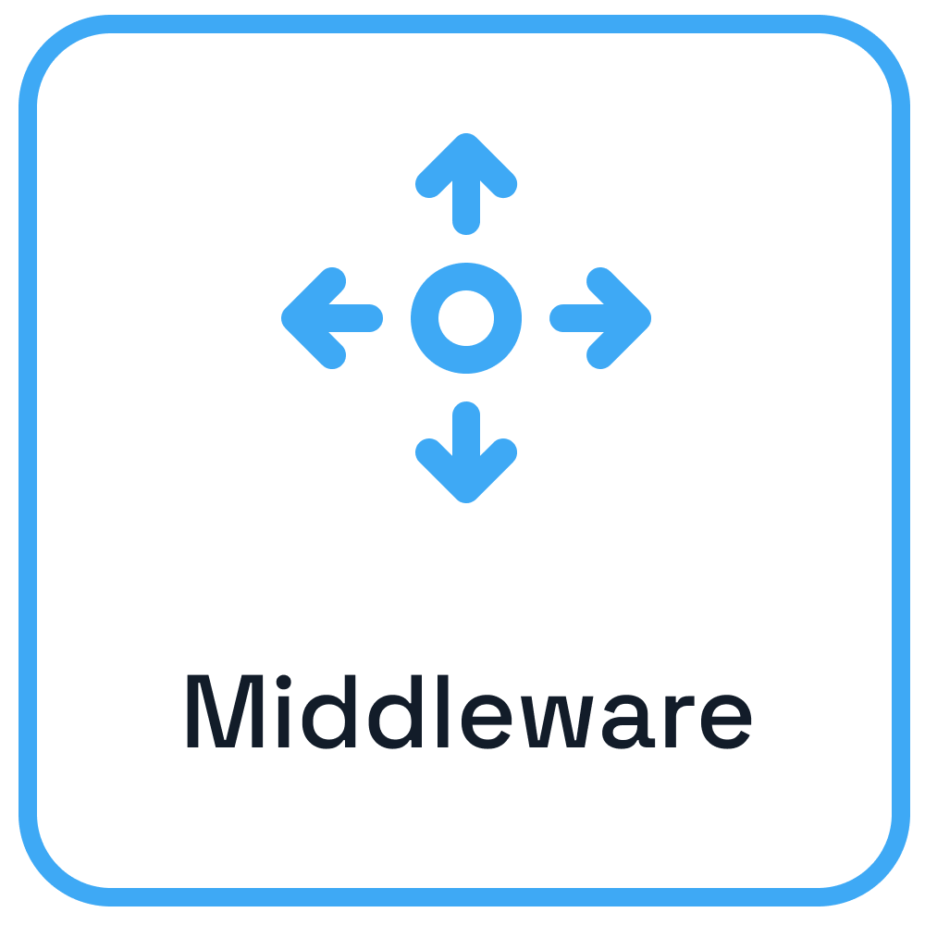
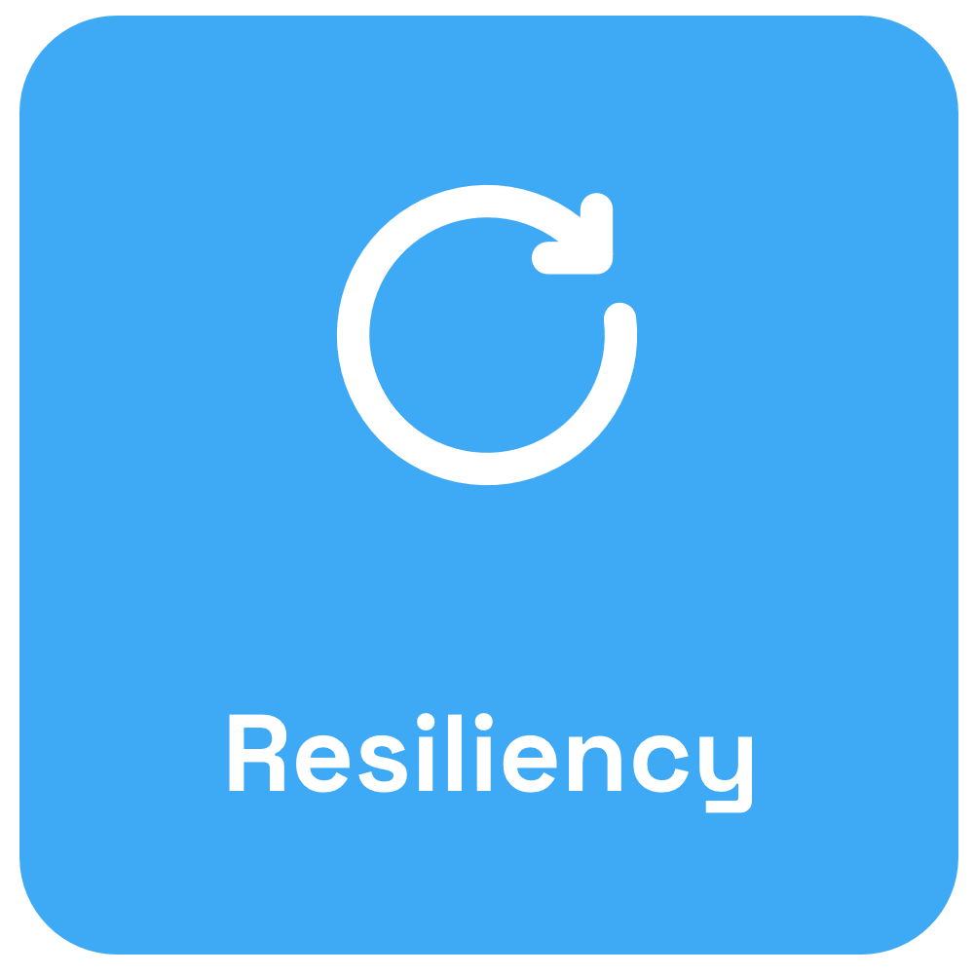








Dapr from development to hosting
Use any language or runtime
App
HTTP/gRPC
Host on & integrate with any cloud or edge infrastructure
Databases
Message Brokers
Services

Slide 18
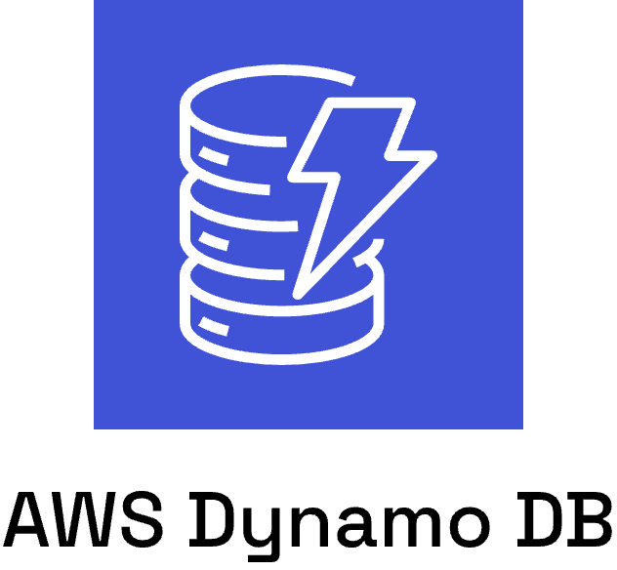



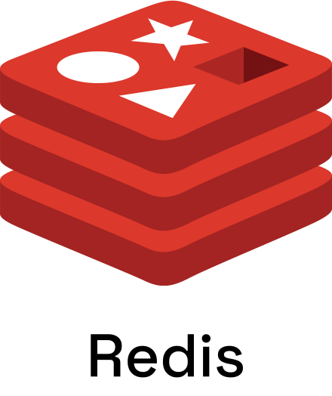
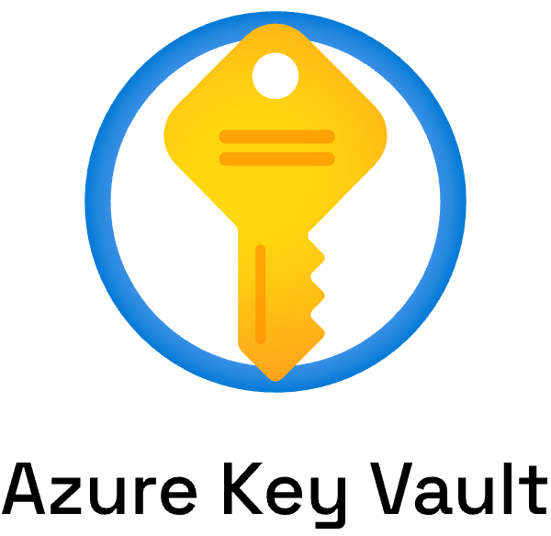
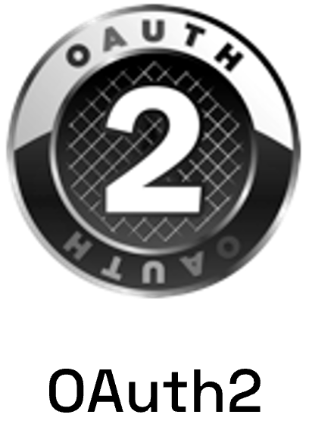

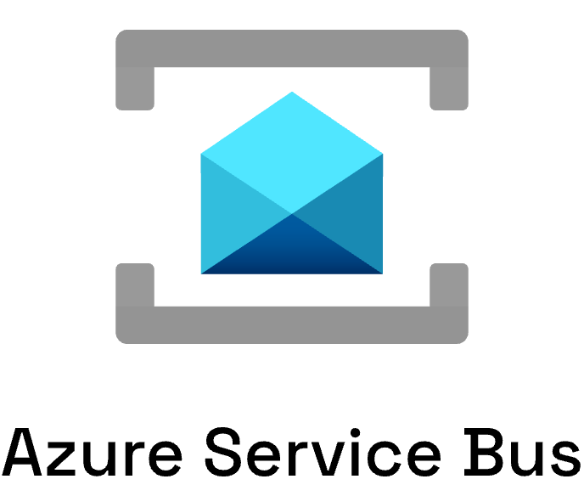
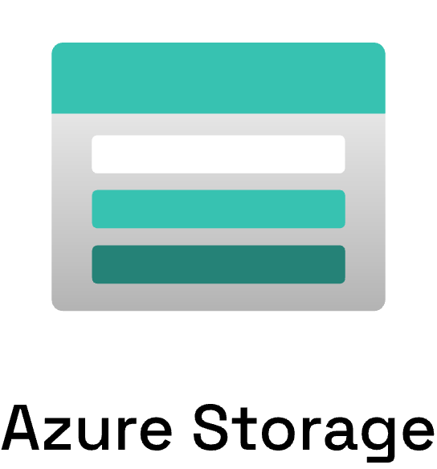
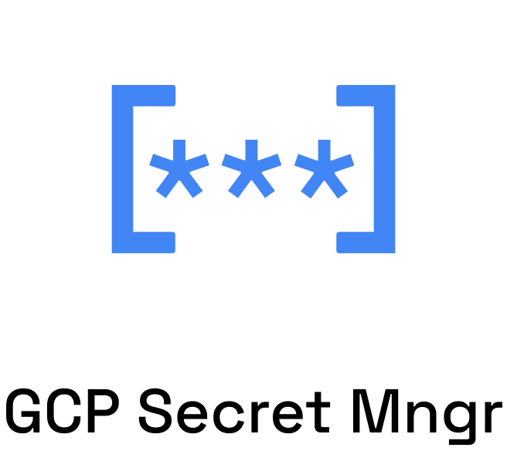
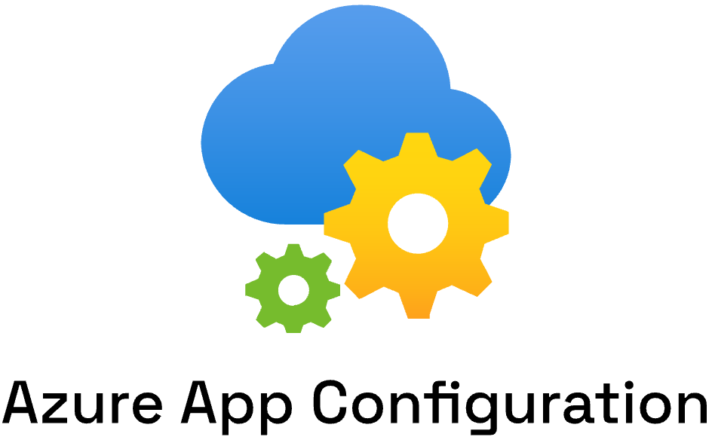

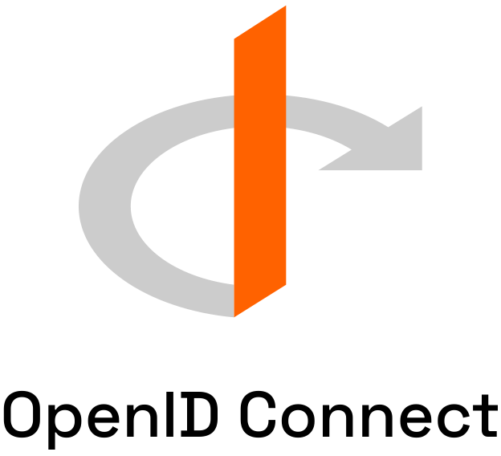

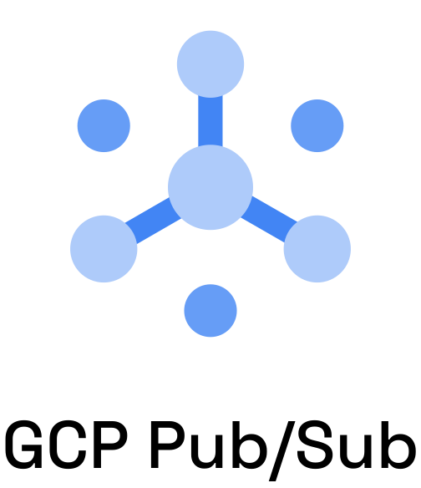
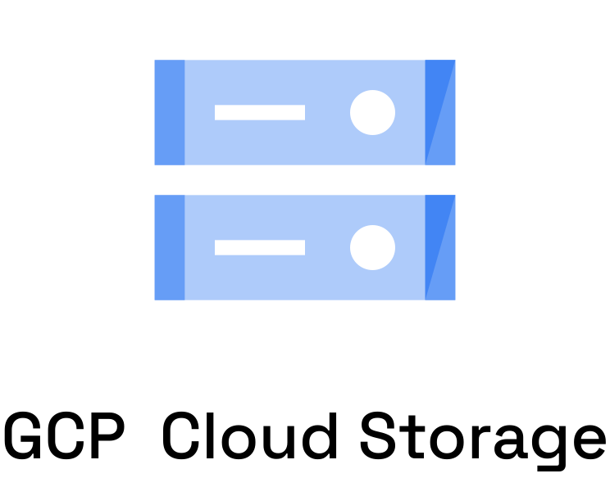

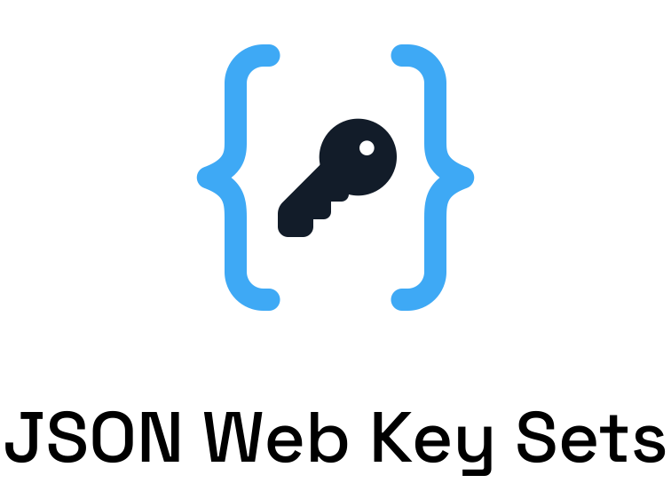










Dapr components
App

Slide 19
Sidecar pattern and the Dapr API
Dapr API
My App
App
HTTP/gRPC
Application code
Dapr sidecar
POST http://localhost:3500/v1.0/invoke/cart/method/order
GET http://localhost:3500/v1.0/state/inventory/item50
POST http://localhost:3500/v1.0/publish/mybroker/order-messages
GET http://localhost:3500/v1.0/secrets/vault/dbaccess
POST http://localhost:3500/v1.0-beta1/workflows/dapr/businessprocess/start

Slide 20





Using the Dapr APIs
Input Binding Trigger
GET /v1.0/secrets/
POST /v1.0/publish/
Subscription
POST /v1.0/binding/
App A
Message broker
App C
GET /dapr/subscribe/
POST /v1.0/invoke/
POST /v1.0/state/
App B
Storage
GET /v1.0/configuration/

Slide 21
Swappable component model
Local dev
Local file
In memory

Slide 22
Swappable component model

Slide 23
Swappable component model

Slide 24
Swappable component model

Slide 25
Swappable component model

Slide 26






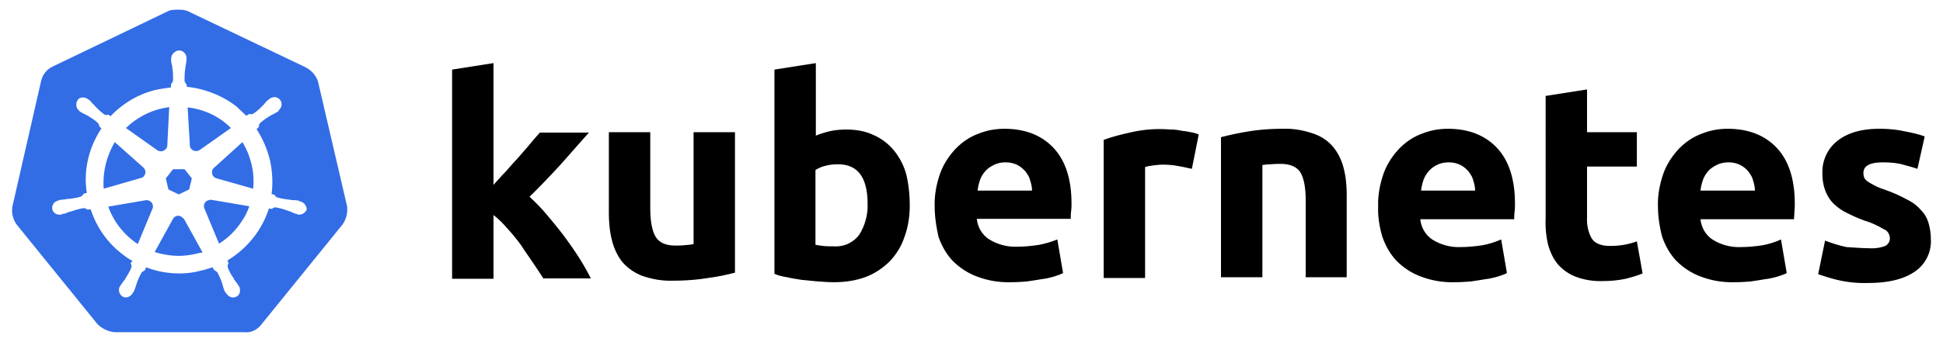
Use Dapr anywhere
Azure Container Apps

Slide 27









Dapr community
12/157
120
700k+
300k
Largest CNCF project
Community components
Docker Hub pulls/month
Unique doc views/month
📖
29k
3k
7k
GitHub stars
Discord members
Contributors
⭐

Slide 28
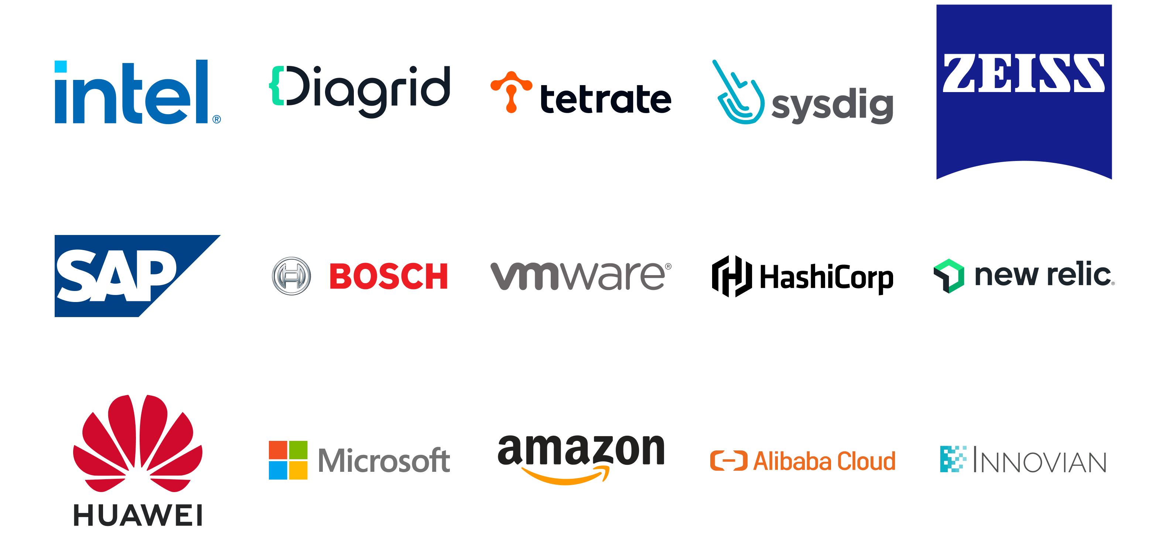
Dapr contributors

Slide 29
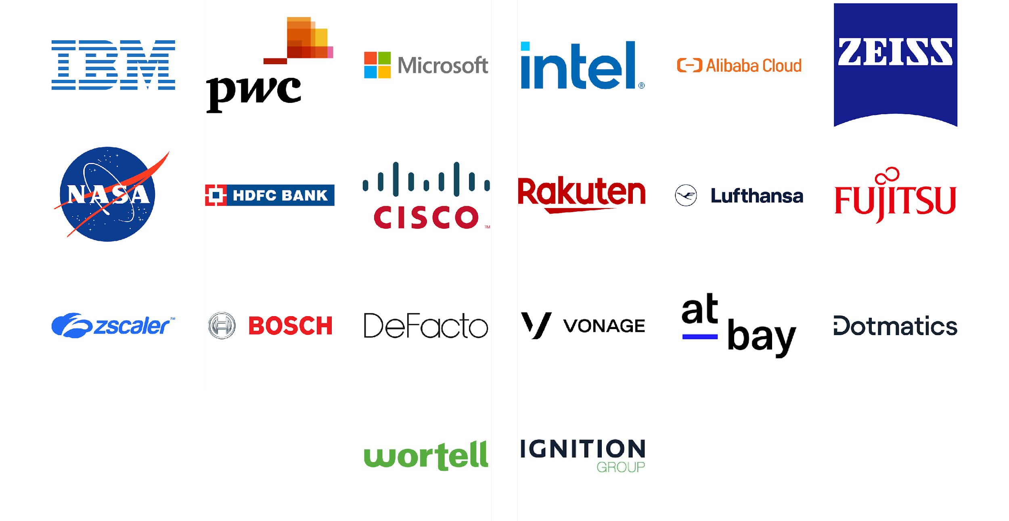
Dapr users

Slide 30
Dapr APIs & Cross cutting concerns
App B
App A
App C

Slide 31
Service Invocation API
https://docs.dapr.io/developing-applications/building-blocks/service-invocation/

Slide 32
Service Invocation
- Service discovery via name resolution components
- Invoke HTTP and gRPC services consistently
- Configurable resiliency policies
- Built-in distributed tracing & metrics
- Access control policies & mTLS
- Chain pluggable middleware components
The service invocation API allows synchronous communication between services.

Slide 33
Service Invocation
Customer
Checkout
POST http://localhost:3500/v1.0/invoke/checkout/method/order
POST http://localhost:5100/order

Slide 34



Service Invocation
Name resolution component for service discovery
Observability backend
DNS
Invoke method
Customer
Checkout
mTLS encryption
POST http://localhost:3500/v1.0/invoke/checkout/method/order
POST http://localhost:5100/order
Notes:
Name Resolution component for service discovery: mDNS, Kubernetes DNS, Hashicorp Consul

Slide 35
Service Invocation in JavaScript
const order = {orderId: 1};
const url = `${daprHost}:${daprPort}/order`
const response = await fetch(url, {
method: "POST",
headers: {
"dapr-app-id": "order-processor",
},
body: JSON.stringify(order),
});

Slide 36
Service Invocation Demo
https://docs.dapr.io/getting-started/quickstarts/serviceinvocation-quickstart/

Slide 37
Publish / Subscribe API
https://docs.dapr.io/developing-applications/building-blocks/pubsub/

Slide 38
Publish / Subscribe
- Integrates with many message brokers and queues
- Guaranteed at least one delivery
- Use declarative or programmatic subscriptions
- Use content-based message routing
- Set dead-letter topics and resiliency policies
- Limit publish and subscribe access by using scopes
The publish subscribe API allows asynchronous communication between services.

Slide 39
Publish / Subscribe
Publisher
Message
broker
Subscriber
POST http://localhost:3500/v1.0/publish/mybroker/order-messages
POST http://localhost:5100/orders

Slide 40

Publish / Subscribe
Observability backend
Cloudevents
Publisher
Message
broker
Subscriber
POST http://localhost:3500/v1.0/publish/mybroker/order-messages
POST http://localhost:5100/orders

Slide 41
Publish / Subscribe Component
apiVersion: dapr.io/v1alpha1
kind: Component
metadata:
name: mybroker
spec:
type: pubsub.redis
version: v1
metadata:
- name: redisHost
value: localhost:6379
- name: redisPassword
value: ""
Observability backend
Cloudevents
Publisher
Message
broker
Subscriber
POST http://localhost:3500/v1.0/publish/mybroker/order-messages
POST http://localhost:5100/orders

Slide 42
Publish / Subscribe with JavaScript SDK
Publish
const client = new DaprClient({ daprHost, daprPort }); const order = { orderId: 1 };
await client.pubsub.publish(“mypubsub”, “new-orders”, order);
Subscribe
const server = new DaprServer({ serverHost, serverPort, clientOptions: { daprHost, daprPort }
}); server.pubsub.subscribe(“mypubsub”, “new-orders”, data =>
console.log("Subscriber received: " + JSON.stringify(data))
); await server.start();

Slide 43
Publish / Subscribe Demo
https://docs.dapr.io/getting-started/quickstarts/pubsub-quickstart/

Slide 44
State Management API (Key/Value)
https://docs.dapr.io/developing-applications/building-blocks/state-management/

Slide 45
State Management
- Integrates with many state stores
- Configurable concurrency and consistency behaviors
- Use bulk operations
- Use resiliency policies
- Limit access by using scopes
The state management API allows key/value pair storage across many supported state stores.

Slide 46
State Management (Key/Value)
key | field | value
orders||order1 | data | "{orderId:1}"
orders||order1 | version | 1
Orders
State store
POST http://localhost:3500/v1.0/state/mystatestore
[{
“key”: “order1”,
“value”: “{orderId: 1}”
}]

Slide 47
State Management (Key/Value)
key | field | value
orders||order1 | data | "{orderId:1}"
orders||order1 | version | 1
Orders
State store
GET http://localhost:3500/v1.0/state/mystatestore/order1

Slide 48
State Management with JavaScript SDK
Save
const client = new DaprClient({ daprHost, daprPort });
const order = { orderId: 1 }
const state = [{ key: order.orderId, value: order }];
await client.state.save("mystatestore", state);
Get
const savedOrder = await client.state.get("mystatestore", order.orderId);

Slide 49
State Management (Key/Value) Demo
https://docs.dapr.io/getting-started/quickstarts/statemanagement-quickstart/

Slide 50
Dapr Workflow
https://docs.dapr.io/developing-applications/building-blocks/workflow/

Slide 51
Dapr Workflow
- Durable execution due to persisting workflow state
- Works seamlessly with other Dapr APIs
- Author workflows in C#, Java, Python or JavaScript
- Apply patterns such as: chaining, fan-out/fan-in, wait for external events, durable timers, child workflows.
BETA
The workflow API enables the durable execution of potentially long running business processes.

Slide 52


Workflow example
Receive message
Start
Get secret
Activity A
External Event
Wait for event
Invoke an API
Activity B
Activity C
Store event result
Activity D
Publish message
End

Slide 53
Task Chaining
Start
With task changing, multiple activities are executed in succession. Use this pattern when the order of execution is important. The output from one activity can be used as the input for the next activity.
Activity A
Activity B
Activity C
End

Slide 54
Task Chaining with with .NET SDK
var result1 = await context.CallActivityAsync<string[]>("Step1", workflowInput);
var result2 = await context.CallActivityAsync<int[]>("Step2", result1);
var result3 = await context.CallActivityAsync<string>("Step3", result2);
return result3;

Slide 55
Fan-out/Fan-in
Start
With fan-out/fan-in, multiple activities can be executed simultaneously. Use this pattern when the activities are independent of each other. The result of the activities can be aggregated in the workflow.
Activity A
Activity B
Activity C
End

Slide 56
Fan-out/Fan-in with .NET SDK
// Get a list of N work items to process in parallel.
object[] workBatch = await context.CallActivityAsync<object[]>("GetWorkBatch", null);
// Schedule the parallel tasks, but don't wait for them to complete yet.
var parallelTasks = new List<Task<int>>(workBatch.Length);
for (int i = 0; i < workBatch.Length; i++)
{
Task<int> task = context.CallActivityAsync<int>("ProcessWorkItem", workBatch[i]);
parallelTasks.Add(task);
}
// Everything is scheduled. Wait here until all parallel tasks have completed.
await Task.WhenAll(parallelTasks);
// Aggregate all N outputs and publish the result.
int sum = parallelTasks.Sum(t => t.Result);
await context.CallActivityAsync("PostResults", sum);

Slide 57
Monitor
Start
With the monitor pattern, a recurring activity is executed. This is usually combined with a timer to introduce a delay. Use this pattern to periodically check a status of a system and perform an action based on that status.
Activity
CreateTimer
Wait with further execution of the workflow
ContinueAsNew
Restart the workflow without the history

Slide 58
Monitor with .NET SDK
var status = await context.CallActivityAsync<string>("GetStatus");
if (status == "healthy")
{
myEntityState.IsHealthy = true;
myEntityState.UnHealthyCount = 0;
}
else
{
myEntityState.IsHealthy = false;
myEntityState.UnHealthyCount += 1;
if (myEntityState.UnHealthyCount > 3)
{
await context.CallActivityAsync("SendAlert", myEntityState);
}
}
// Put the workflow to sleep until the determined time
await context.CreateTimer(TimeSpan.FromMinutes(30));
// Restart from the beginning with the updated state
context.ContinueAsNew(myEntityState);

Slide 59
External System Interaction
Start
The external system interaction pattern allows the workflow to pause until an event is received that originates from an external source. The event could be triggered by a person who needs to approve a step in a business process.
GetApproval
Approval Event
Wait for event
Approved
Not Approved
End

Slide 60
External System Interaction with .NET SDK
await context.CallActivityAsync("RequestApproval", order);
// Pause and wait for a human to approve the order
var approvalResult = await context.WaitForExternalEventAsync<ApprovalResult>(
eventName: "ManagerApproval",
timeout: TimeSpan.FromDays(3));
if (approvalResult == ApprovalResult.Rejected)
{
// The order was rejected, end the workflow here
return new OrderResult(Processed: false);
}
else
{
await context.CallActivityAsync("OrderExpensiveItem", order);
}

Slide 61
Workflow Engine
POST http://localhost:3500/v1.0-beta1/workflows/dapr/businessprocess/start
Schedule workflow / activity
Workflow App
gRPC stream
Return results
Workflow and Activity definitions
Dapr Workflow engine
Append only state store

Slide 62
Workflow Engine built on Dapr Actors
Orchestrator Actor
Workflow App
Customer
Workflow engine
Append only state store
Workflow and Activity definitions
Activity Actor

Slide 63
Workflow Demo
https://docs.dapr.io/getting-started/quickstarts/workflow-quickstart/

Slide 64
Bindings API
https://docs.dapr.io/developing-applications/building-blocks/configuration/

Slide 65
Bindings
- Trigger applications via external messaging systems
- Keep application code free from external
SDKs / libraries
- Switch bindings at runtime
- Use resiliency policies
- Build portable apps with environment specific bindings
The bindings API allows apps to be triggered by incoming events and interface with external systems.

Slide 66

Output Bindings
My App
Twilio
POST http://localhost:3500/v1.0/bindings/twilio
{
“data”: “Hello World!”
}
Notes:
Name Resolution component for service discovery: mDNS, Kubernetes DNS, Hashicorp Consul

Slide 67
Output Bindings with JavaScript SDK
const client = new DaprClient({ daprHost, daprPort });
let sqlCmd = `insert into orders (orderid, customer, price) values (${order.orderid}, '${order.customer}', ${order.price});`;
let payload = `{"sql": "${sqlCmd}"} `;
client.binding.send(“mypostgres”, "exec", "", JSON.parse(payload));
Notes:
Name Resolution component for service discovery: mDNS, Kubernetes DNS, Hashicorp Consul

Slide 68

Input Bindings
My App
Kafka
Notes:
Name Resolution component for service discovery: mDNS, Kubernetes DNS, Hashicorp Consul

Slide 69
Input Bindings
My App
Kafka
[ApiController]
public class CheckoutServiceController : Controller
{
[HttpPost("/checkout")]
public ActionResult<string> getCheckout([FromBody] int orderId)
{
Console.WriteLine("Received Message: " + orderId);
return "CID" + orderId;
}
}
Notes:
Name Resolution component for service discovery: mDNS, Kubernetes DNS, Hashicorp Consul

Slide 70
Input Bindings
apiVersion: dapr.io/v1alpha1
kind: Component
metadata:
name: checkout
spec:
type: bindings.kafka
version: v1
metadata:
# Kafka broker connection setting
- name: brokers
value: localhost:9092
# consumer configuration: topic and consumer group
- name: topics
value: sample
- name: consumerGroup
value: group1
# publisher configuration: topic
- name: publishTopic
value: sample
- name: authRequired
value: false
- name: direction
value: input
My App
Kafka
[ApiController]
public class CheckoutServiceController : Controller
{
[HttpPost("/checkout")]
public ActionResult<string> getCheckout([FromBody] int orderId)
{
Console.WriteLine("Received Message: " + orderId);
return "CID" + orderId;
}
}
Notes:
Name Resolution component for service discovery: mDNS, Kubernetes DNS, Hashicorp Consul

Slide 71
Bindings Demo
https://docs.dapr.io/getting-started/quickstarts/bindings-quickstart/

Slide 72
Secrets Management API
https://docs.dapr.io/developing-applications/building-blocks/secrets/secrets-overview/

Slide 73
Secrets Management
- Integrates with public cloud and cloud-native secret stores
- Safely access secrets in your applications
- Reference secrets in Dapr components
- Use scopes to limit access
The secrets management API enables access to sensitive information in secret stores.

Slide 74

Secrets Management
My App
Secret store
RESPONSE
{
“mysecret”: “secretvalue”
}
GET http://localhost:3500/v1.0/secrets/myvault/mysecret
Notes:
Name Resolution component for service discovery: mDNS, Kubernetes DNS, Hashicorp Consul

Slide 75
Secrets Management with JavaScript SDK
const client = new DaprClient({ daprHost, daprPort });
const secret = await client.secret.get(“mysecretstore”, “mysecret”);
Notes:
Name Resolution component for service discovery: mDNS, Kubernetes DNS, Hashicorp Consul

Slide 76
Secrets Management Demo
https://docs.dapr.io/getting-started/quickstarts/secrets-quickstart/

Slide 77
External Configuration API
https://docs.dapr.io/developing-applications/building-blocks/configuration/

Slide 78
External configuration
The external configuration API enables read access to configuration data.
- Integrates with many configuration stores
- Subscribe to configuration changes
- Use scopes to limit access

Slide 79

External Configuration
My App
External configurationstore
RESPONSE
{
“config1”: { “value” : “configvalue”
}
}
GET http://localhost:3500/v1.0/configuration/myconfig?key=config1
Notes:
Name Resolution component for service discovery: mDNS, Kubernetes DNS, Hashicorp Consul

Slide 80
External Configuration with JavaScript SDK
const client = new DaprClient({ daprHost, daprPort });
const configItemKeys = [”key1", ”key2"];
const config = await client.configuration.get("myconfigstore", configItemKeys);
Notes:
Name Resolution component for service discovery: mDNS, Kubernetes DNS, Hashicorp Consul

Slide 81
External Configuration Demo
https://docs.dapr.io/getting-started/quickstarts/configuration-quickstart/

Slide 82
Actors API
https://docs.dapr.io/developing-applications/building-blocks/actors/

Slide 83
Actors
- Uses the Virtual Actor pattern
- State is persisted in a configurable state store
- Uses turn-based access in concurrent systems
- Built-in actor distribution and fail-over
- Schedule period work using timers & reminders
- Author actors in C#, Java, JavaScript, Python and Go
- Use the Actors API with any language
The Actors API allows to write concurrent applications using the actor model.

Slide 84
Virtual Actor Model
Actor lifetime is not tied to their in-memory representation. No need to explicitly create or destroy an actor.
Notes:
Name Resolution component for service discovery: mDNS, Kubernetes DNS, Hashicorp Consul

Slide 85
Actor placement
Pod 1
My App
POST /v1.0/actors/MyActor/A/method/update
App Instance 1
MyActor A
3
2
1
MyActor B
Pod 2
Actor Type | Dapr Instances
MyActor | Partition1 Partition2
OtherActor | Partition 2
1
Placement Service
App Instance 2
MyActor C
OtherActor A
Notes:
Name Resolution component for service discovery: mDNS, Kubernetes DNS, Hashicorp Consul

Slide 86
Actors API
Invoke the update method on MyActor “A”
Create actor reminder
POST /v1.0/actors/MyActor/A/method/update
POST /v1.0/actors/MyActor/A/reminders/process
Save MyActor “A” state
Create actor timer
POST /v1.0/actors/MyActor/A/state
POST /v1.0/actors/MyActor/A/timer/process
Get MyActor “A” state
GET /v1.0/actors/MyActor/A/state/key
Notes:
Name Resolution component for service discovery: mDNS, Kubernetes DNS, Hashicorp Consul

Slide 87
Authoring Actors with .NET SDK
public interface ISmartDevice : IActor
{
Task<string> SetDataAsync(SmartDeviceData device);
Task<SmartDeviceData> GetDataAsync();
Task DetectSmokeAsync();
Task SoundAlarm();
Task ClearAlarm();
}
public class SmartDeviceData
{
public string Status { get; set; } = default!;
public string Location { get; set; } = default!; }
Notes:
Name Resolution component for service discovery: mDNS, Kubernetes DNS, Hashicorp Consul

Slide 88
Authoring Actors with .NET SDK
var deviceActorId1 = new ActorId("device1");
// Create a new instance of the data class that will be stored in the actor
var deviceData1 = new SmartDeviceData(){
Location = "First Floor",
Status = "Ready",
};
// Create the local proxy by using the same interface that the service implements.
// You need to provide the type and id so the actor can be located.
// If the actor matching this id does not exist, it will be created
var proxySmartDevice1 = ActorProxy.Create<ISmartDevice>(
deviceActorId1,
"SmokeDetectorActor");
// Now you can use the actor interface to call the actor's methods.
var setDataResponse1 = await proxySmartDevice1.SetDataAsync(deviceData1);
Notes:
Name Resolution component for service discovery: mDNS, Kubernetes DNS, Hashicorp Consul

Slide 89
Actors Demo
https://docs.dapr.io/getting-started/quickstarts/actors-quickstart/

Slide 90
Distributed Lock API
https://docs.dapr.io/developing-applications/building-blocks/distributed-lock/

Slide 91
Distributed lock
ALPHA
- Only a single instance of an application can hold a lock
- Locks are scoped to a Dapr app-id
- Uses a lease-based locking mechanism to prevent deadlocks
The distributed lock API provides mutually exclusive access to resources.

Slide 92


Distributed lock
POST http://localhost:3500/v1.0-alpha1/lock/statestore
My App
{
"resourceId" : “lock1",
"lockOwner" : “app1",
"expiryInSeconds": 60
}
Lock component
State store
Notes:
Name Resolution component for service discovery: mDNS, Kubernetes DNS, Hashicorp Consul

Slide 93

Distributed lock
POST http://localhost:3500/v1.0-alpha1/lock/statestore
App instance 1
{
"resourceId" : “lock1",
"lockOwner" : “app1",
"expiryInSeconds": 60
}
Lock component
State store
App instance 1
Notes:
Name Resolution component for service discovery: mDNS, Kubernetes DNS, Hashicorp Consul

Slide 94

Distributed lock
POST http://localhost:3500/v1.0-alpha1/unlock/statestore
App instance 1
{
"resourceId" : “lock1",
"lockOwner" : “app1“
}
Lock component
State store
App instance 1
Notes:
Name Resolution component for service discovery: mDNS, Kubernetes DNS, Hashicorp Consul

Slide 95
Cryptography API
https://docs.dapr.io/developing-applications/building-blocks/cryptography/

Slide 96
Cryptography
- Perform cryptographic operations securely
- Use external vaults or cryptographic components
- Enables better separation of concerns and least privilege practices
ALPHA
The cryptography API enables safe encryption and decryption in your applications.

Slide 97
Cryptography
Cloud
Encrypt & Decrypt API
My App
Generic
Built-in cryptographic engine (for generic components)
Notes:
Name Resolution component for service discovery: mDNS, Kubernetes DNS, Hashicorp Consul

Slide 98
Cryptography Demo
https://docs.dapr.io/getting-started/quickstarts/cryptography-quickstart/

Slide 99
Jobs API
https://docs.dapr.io/developing-applications/building-blocks/jobs/jobs-overview/

Slide 100
Jobs
ALPHA
The Jobs API is an orchestrator that schedules tasks to be executed at a specific time or on a specific interval.
- Uses the Scheduler Service to schedule tasks
- Guarantees at least once delivery
- Combine it with other Dapr APIs such as delaying pub/sub messages or schedule service invocation calls

Slide 101

Jobs
Scheduler
gRPC / HTTP calls
schedule/get/delete
My App
OnJobEvent
WatchJobs
Sidecar
Notes:
Name Resolution component for service discovery: mDNS, Kubernetes DNS, Hashicorp Consul

Slide 102
Security
https://docs.dapr.io/concepts/security-concept/

Slide 103
Secure Dapr to Dapr communication
Service A
Service B
mTLS

Slide 104
mTLS in K8s mode
Sentry Pod
Read existing root/issuer cert
OR Create self-signed cert
Pod A
Pod B
(optional) Operator brings existing root and issues certs
Service A
Request workload certificate
Service B
mTLS
Inject trust anchors (root cert)
Operator
Injector Pod
Read root cert

Slide 105

Access policies
apiVersion: dapr.io/v1alpha1
kind: Configuration
metadata:
name: appconfig
namespace: default
spec:
api:
allowed:
- name: invoke
version: v1
protocol: grpc
- name: pubsub
version: v1
protocol: grpc
MyApp

Slide 106

Access policies
apiVersion: dapr.io/v1alpha1
kind: Configuration
metadata:
name: appconfig
spec:
accessControl:
defaultAction: deny
trustDomain: "public"
policies:
- appId: app1
defaultAction: allow
trustDomain: 'public'
namespace: "default"
App1
MyApp
App2

Slide 107
Observability
https://docs.dapr.io/concepts/observability-concept/

Slide 108



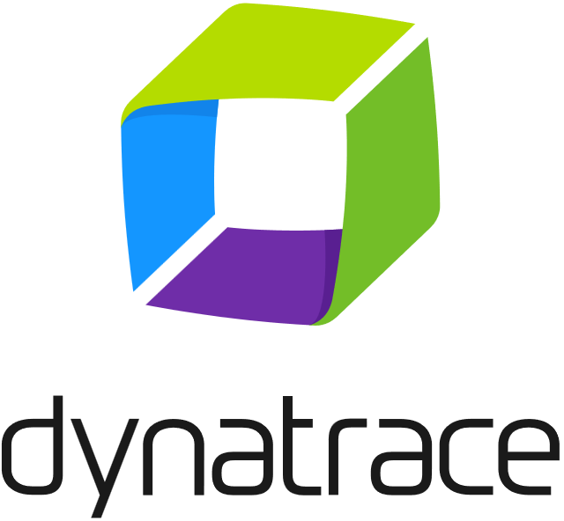


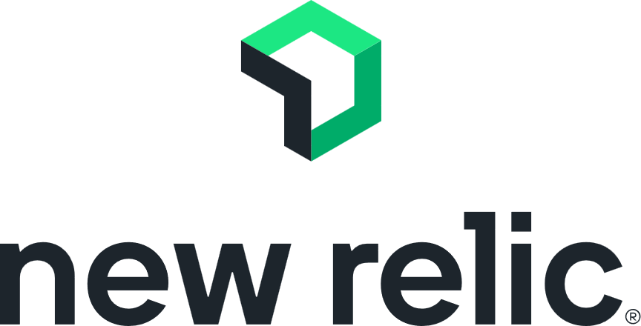
Distributed tracing
Monitoring tools
App label
Tracing
Service invocation
Tracing
Tracing
App label
App label
Publish
Message
broker
Subscribe

Slide 109
Resiliency
https://docs.dapr.io/concepts/resiliency-concept/

Slide 110

Service invocation resiliency
The built-in service invocation retries are always performed with a backoff interval of 1 second up to a threshold of 3 times.
App A
App B
Additionally, service invocation resiliency polices for retries, timeouts and circuit breakers can be applied.

Slide 111
Outbound component resiliency
Component resiliency polices can be applied to outbound component calls. For example, calls to a state store.
App
Outbound
State Store
Additionally, some components have retry capabilities built-in. The policies are configured on a per component basis.

Slide 112

Inbound component resiliency
Resiliency polices can be applied to inbound component calls. For example, pub/sub subscriptions and input bindings.
App label
Inbound
App
Cron input binding

Slide 113
Pub/Sub resiliency
Outbound component resiliency policies for can be applied to message publishing.
Inbound component resiliency polices can be applied to subscriptions when delivering messages.
Outbound
Inbound
App A
Message
broker
App B
Additionally, many pub/sub components have retry capabilities built-in. The policies are configured on a per component basis.

Slide 114
Resiliency
apiVersion: dapr.io/v1alpha1
kind: Resiliency
metadata:
name: myresiliency
scopes:
- order-processor
spec:
policies:
retries:
retryForever:
policy: constant
duration: 5s
maxRetries: -1
circuitBreakers:
simpleCB:
maxRequests: 1
timeout: 5s
trip: consecutiveFailures >= 5
targets:
components:
statestore:
outbound:
retry: retryForever
circuitBreaker: simpleCB
Resiliency patterns can be applied across Dapr APIs:
Retries
Timeouts
Circuit breakers
Declarative and decoupled from application code.
Available across all component types, service invocation, and actors.

Slide 115
Hosting modes

Slide 116



Hosting modes
Self-hosted
Run dapr init to install Docker images.
Run any app with a Dapr side car using dapr run.
Virtual/Physical machines
Self-deploy Dapr control plane and Hashicorp Consul per machine.
Use the Dapr Installer Bundle for airgapped environments.
Run any app with a Dapr side car using dapr run.
Kubernetes
Run dapr init -k to install Dapr (or use Helm). Integrated Dapr control plane. Deploys placement, operator, sentry and injector pods.
Automatically injects a Dapr sidecar into all annotated pods.

Slide 117

Hosting modes
Serverless
The Dapr side car is hosted by a provider. You only manage your applications.

Slide 118



Local development with the Dapr CLI
Docker Desktop
dapr init
placement
Create mapping table of actor instances and pods
App
Use components
redis
State management & pub/sub messaging
dapr run [flags]
zipkin
Send distributed tracing
https://docs.dapr.io/getting-started/install-dapr-cli/

Slide 119


Dapr in self-hosted mode on VMs
VM1
VM2
VM3
App A
App B
Leader
Consul for DNS name resolution
Follower
Follower
Consul
Consul
Consul
Actor placement
Create mapping
table of
actor instances
Actor placement
Actor placement
placement
placement
placement
Cert authority & identity
Assign Spiffe identity
Manage mTLS
Cert authority & identity
Cert authority & identity
sentry
sentry
sentry
Cert store

Slide 120

Dapr on Kubernetes
Pod
Pod
Pod
Pod
Actor partition placement
Dapr runtime injector
Cert authority and identity
Manage component changes
placement
injector
sentry
operator
Create mapping table of actor instance to pods
Inject Dapr sidecar into annotated pods
Inject env variables
Manage mTLS between services
Assign spiffe identity
Manage component updates
Manage Kubernetes service endpoints
Pod
App
Kubelet
Readiness and liveness probe on healthz API to determine Dapr health state
Use components
Host on any cloud or edge infrastructure

Slide 121
Serverless
Azure Container Apps
Dapr API*
Use components
App
Managed
* The number of Dapr APIs offered by serverless platforms can deviate from the APIs in Dapr OSS.
https://docs.dapr.io/operations/hosting/serverless/

Slide 122
Serverless
App Host
Dapr API*
Use components
App
Managed
* The number of Dapr APIs offered by serverless platforms can deviate from the APIs in Dapr OSS.
https://docs.dapr.io/operations/hosting/serverless/

Slide 123





Dapr Resources
dapr.io
bit.ly/dapr-youtube
bit.ly/dapr-quickstarts
bit.ly/dapr-discord
@daprdev
dapr.io

Slide 124


Claim the Dapr Community Supporter badge!
bit.ly/dapr-supporter

Slide 125
Dapr presentation assets
Source

Slide 126
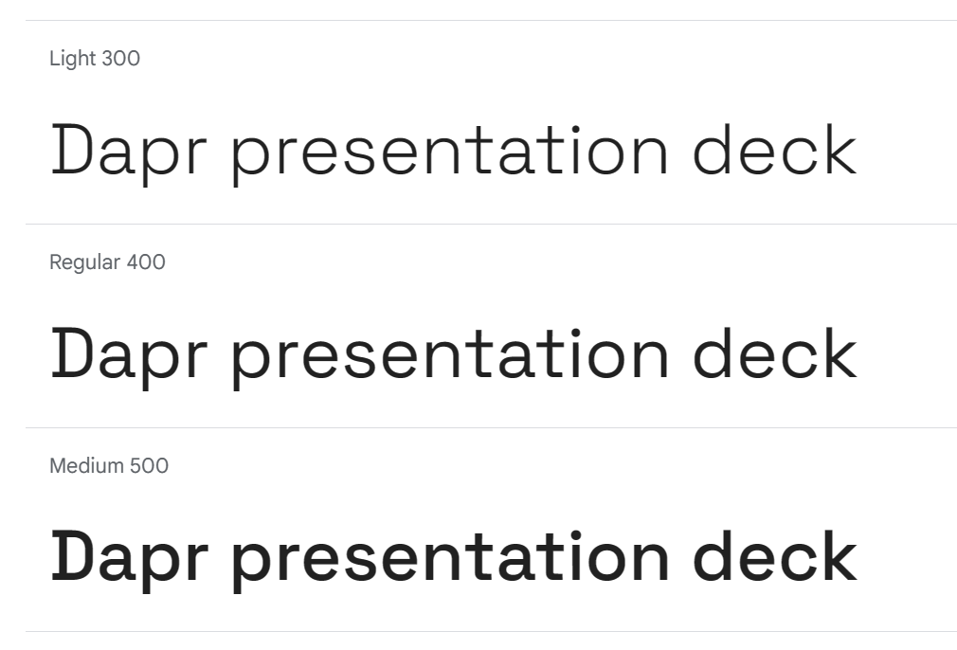
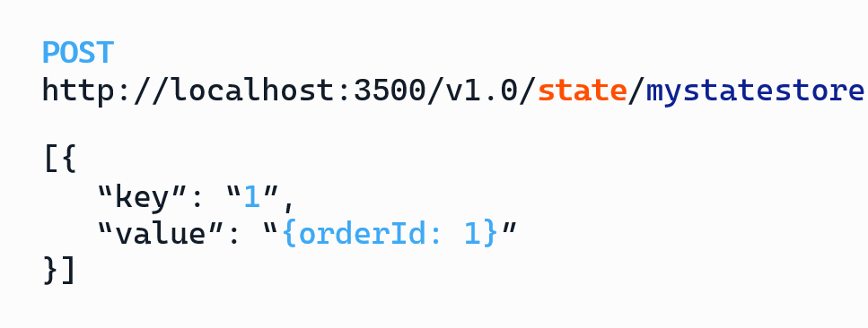
Fonts
Space Grotesk
for all regular texts
and labels
https://fonts.google.com/specimen/Space+Grotesk
CaskadiaCove Nerd Font for code / HTTP endpoints
https://github.com/ryanoasis/nerd-fonts/releases/download/v3.0.2/CascadiaCode.zip
https://www.nerdfonts.com/font-downloads

Slide 127
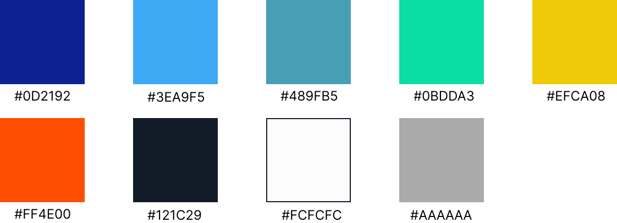
Colors

Slide 128
APIs / Components

Slide 129





API icons and labels
Workflow
Publish / Subscribe
Service invocation
Key/Value
Actors
Middleware
External Configuration
Secrets
Bindings
Cryptography
Distributed lock
Jobs

Slide 130

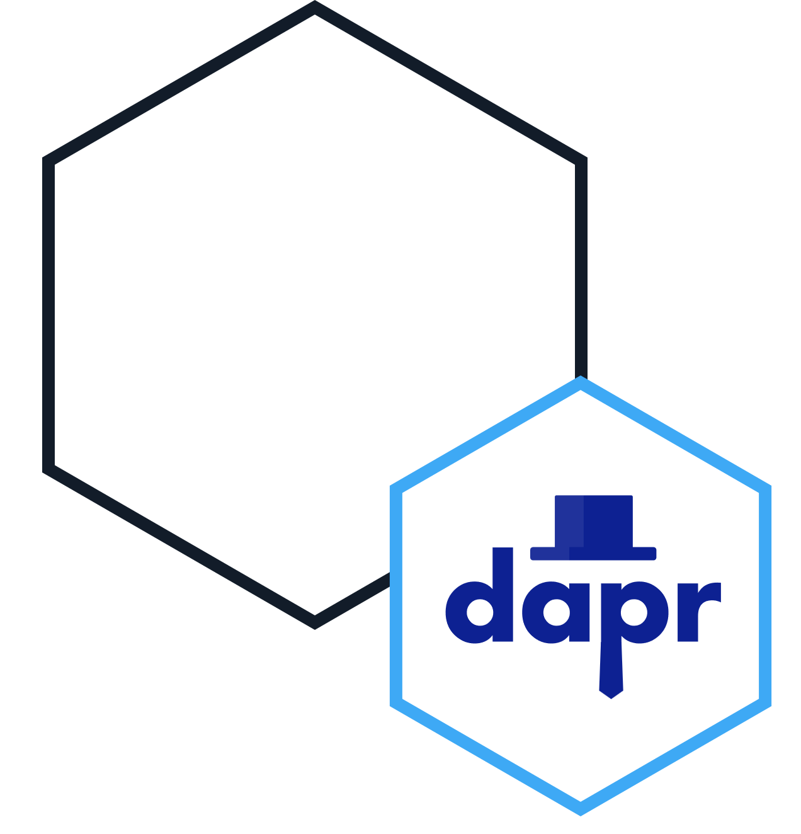


App with Dapr sidecar on the right
App label
App label
App label
App label
App label
App label
App label
App label
App label

Slide 131



App with Dapr sidecar on the left
App label
App label
App label
App label
App label
App label
App label
App label
App label

Slide 132




App hexagons
App label
App label
App label
App label
App label
App label
App label
App label
App label
App label
App label
App label
App label
App label

Slide 133


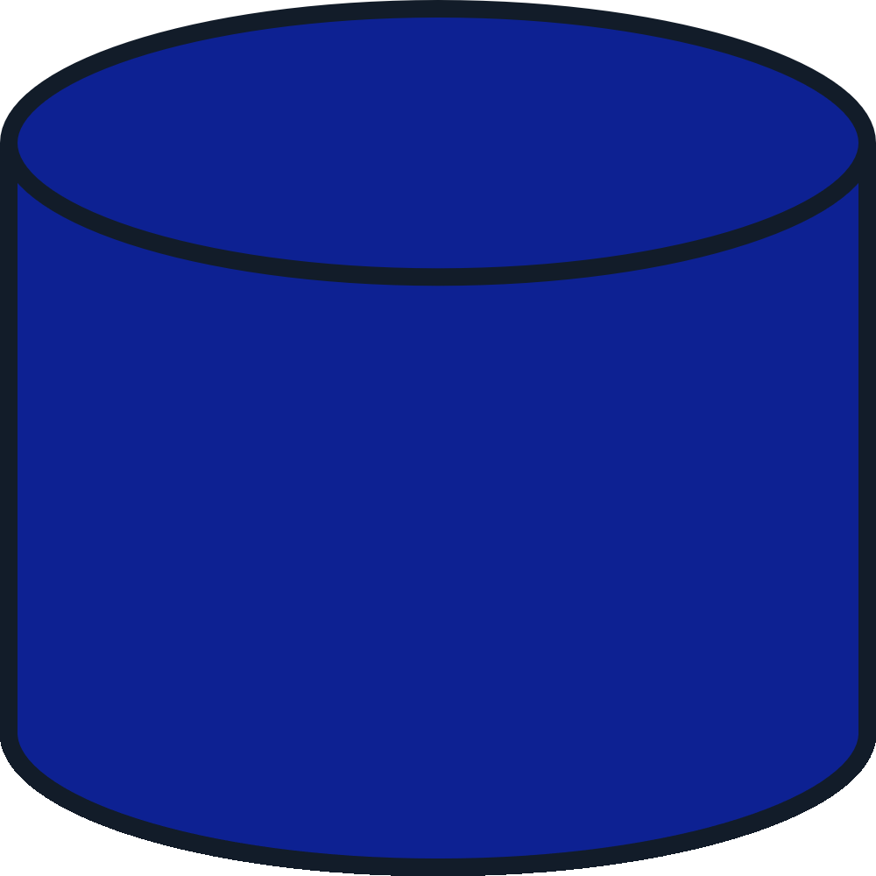

Database label
Database label
Database label
Database label
Database label
Database label
Database label
Database label
Database label

Slide 134






Message broker label
Message broker label
Message broker label
Message broker label
Message broker label
Message broker label
Message broker label
Message broker label
Message broker label

Slide 135






Label
Label
Label
Label
Label
Label
Label
Label
Label

Slide 136
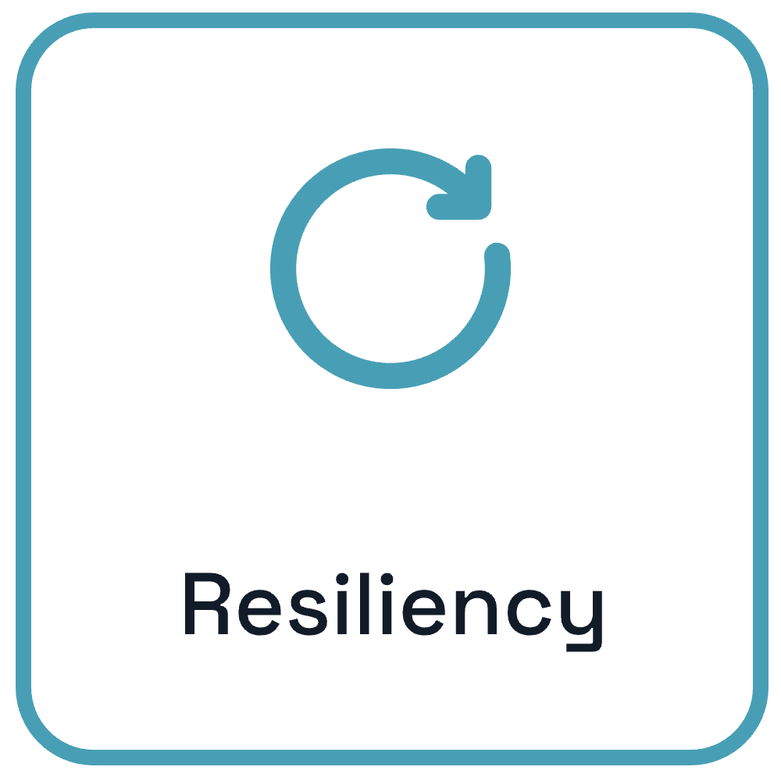


Cross Cutting Concerns

Slide 137



Cross cutting concern icons
Resiliency
Security
Observability
Resiliency
Security
Observability

Slide 138
arrow label
arrow label

Slide 139









Slide 140

Sidecars

Slide 141
Dapr services
placement
sentry
injector
operator

Slide 142

Logo

Slide 143
Languages and runtimes

Slide 144


























Misc Icons
Source: https://icon-sets.iconify.design/fluent/

Slide 145
Hosting
Azure Container Apps

Slide 146























